Slide 1

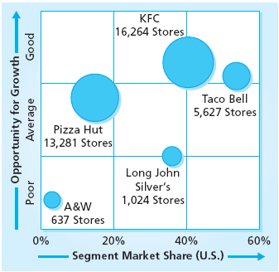
Portfolio Analysis
and Strategic Market Planning
MBM6
Chapter 11
Yum Brands
Store-Brand Portfolio
Chapter 11 Objectives
Portfolio Analysis Models
Portfolio Position and Strategic Market Plan
Portfolio Planning and Portfolio Performance
Note: Sales in proportion to circle size
Copyright Roger J. Best, 2012

Slide 2

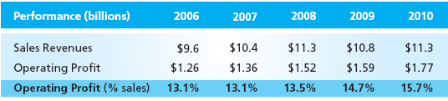
Yum Brands Portfolio Strategy
MBM6
Chapter 11
Invest to Grow – Kentucky Fried Chicken, Taco Bell and Pizza Hut.
Divest – A&W and Long John Silver’s were sold in 2011.
New Market Investment: - The cash freed up from divesting was used to invest growing their 3 core brands internationally.
2011
$12.6
$1.82
$14.4%
Copyright Roger J. Best, 2012

Slide 3
Portfolio Analysis
and Strategic Market Planning
MBM6
Chapter 11
Portfolio Planning
Models
In this section we will review different approaches to Portfolio Analysis.
Copyright Roger J. Best, 2012

Slide 4
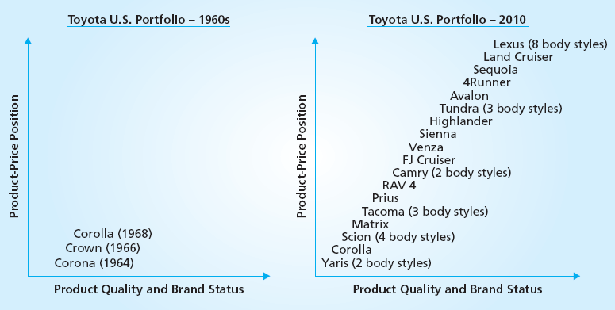
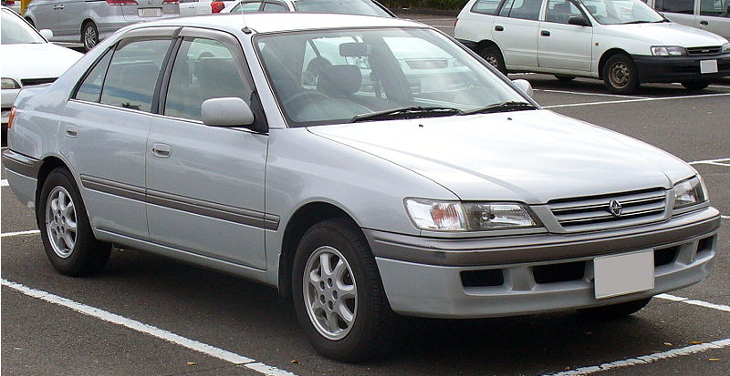
Toyota Product Portfolio
MBM6
Chapter 11
1964 Toyota Corolla
How has the Toyota Product Portfolio evolved and contributed to sales and profitable growth?
Copyright Roger J. Best, 2012

Slide 5
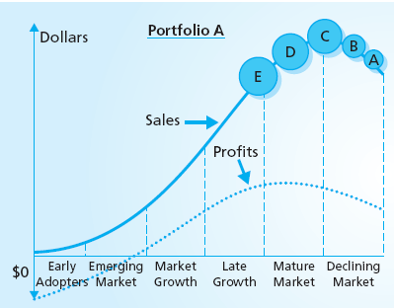
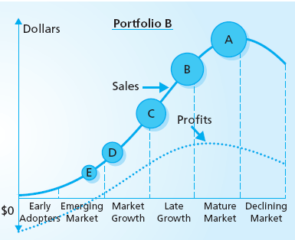
Portfolio Model I Product Lifecycle Portfolio
Marketing Performance Tool 11.1
Let’s assume these are two separate companies. Which would be a better long term investment with respect to a stock purchase?
Copyright Roger J. Best, 2012

Slide 6
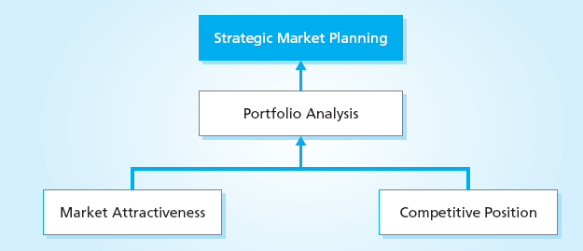
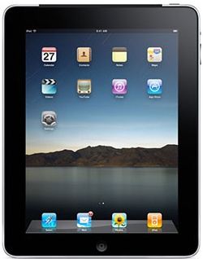

Apple Mac vs. iPad
MBM6
Chapter 11
How does market attractiveness and competitive position differ for these two Apple products?
62%
Mac
Market Demand
Market Share (%)
iPad
6%
Time
Mac iPad
Copyright Roger J. Best, 2012

Slide 7
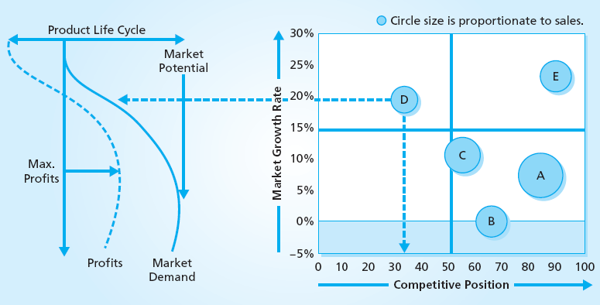
Market Growth as a Measure of Market Attractiveness
MBM6
Chapter 11
Market Growth is often used as a measure of Market Attractiveness. Why?
Copyright Roger J. Best, 2012

Slide 8
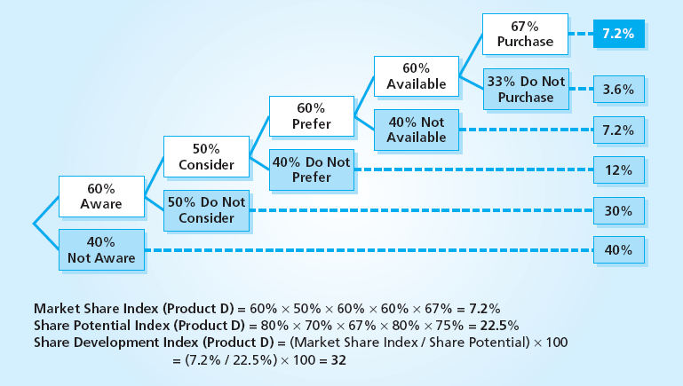
Market Share Development Index
As a Measure of Competitive Position
MBM6
Chapter 11
The Market Share Development index is a good measure of competitive position for strategic management. Why?
Copyright Roger J. Best, 2012

Slide 9
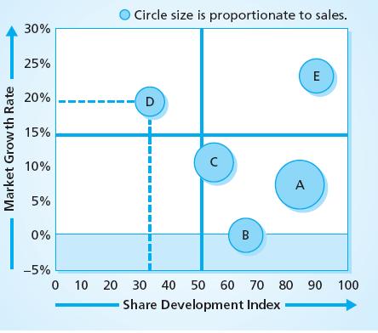
Portfolio Model II:
Market Growth vs. Share Development
Marketing Performance Tool 11.2
Product Portfolio
Product A: Slow growth near full share development
Product B: No growth 65% of share potential.
Product C: 10% growth rate and 50% of share potential.
Product D: 20% growth rate and 33% of share potential,
Product E: 23% growth rate and 90% of share potential
What would be the right investment strategy for each product?
Copyright Roger J. Best, 2012

Slide 10
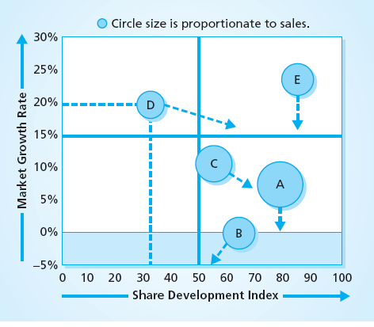
Product Portfolio Share Strategy
MBM6
Chapter 11
Product Portfolio
Product A: Hold Share
Product B: Harvest Share.
Product C: Growth Share.
Product D: Growth Share,
Product E: Hold Share
What is the logic underlying these share strategies?
Copyright Roger J. Best, 2012

Slide 11
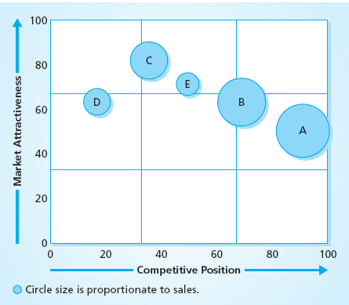
Portfolio Model III: GE-McKinsey
Multi-Factor Portfolio Model
MBM6
Chapter 11
GE-McKinsey Model
Market Attractiveness
Attractiveness based on several factors such as Market Size, Market Growth, Competitive Intensity.
Each is weighted according to importance and then rated based on Market Attractiveness.
Competitive Position
Position based on several factors such as Market Share, Product Performance, Brand Reputation.
Each should be weighted according to importance and then rated based on Competitive Position.
Intel uses this portfolio approach to prioritize new product investment projects.
Copyright Roger J. Best, 2012

Slide 12
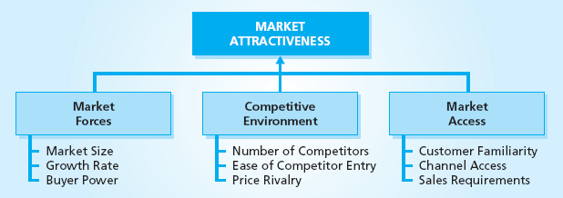
GE-McKinsey Model Market Attractiveness
MBM6
Chapter 11
One approach is to create three major dimensions of Market Attractiveness and then specify a subset of performance metrics for that dimension.
Copyright Roger J. Best, 2012

Slide 13
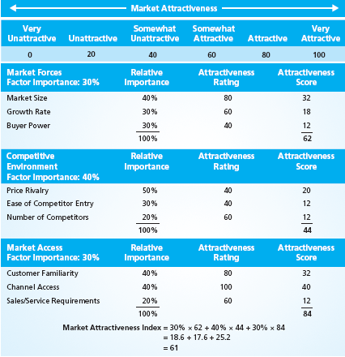
Assessing Market Attractiveness
Marketing Performance Tool 11.3
Usage Process
Select three dimensions of market attractiveness and weight each such the total adds to 100%.
For each dimension identify three areas of measureable market attractiveness.
For each dimension weight the performance metrics such that the total adds to 100%.
Rate each performance metric on a scale fro 0 (very unattractive condition) to 100 (extremely attractive condition).
An overall score (61) is produced along with three dimension scores.
Copyright Roger J. Best, 2012

Slide 14
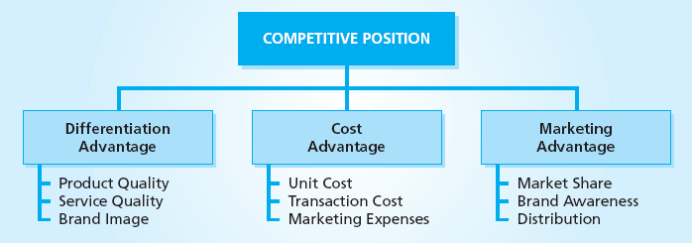
GE-McKinsey Model Market Attractiveness
MBM6
Chapter 11
Create three major dimensions of Competitive Position and then specify a subset of performance metrics for that dimension.
Copyright Roger J. Best, 2012

Slide 15
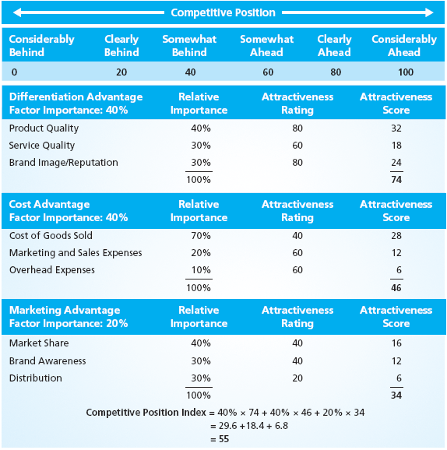
Assessing Competitive Position
Marketing Performance Tool 11.3
Usage Process
Select three dimensions of Competitive Position and weight each such the total adds to 100%.
For each dimension identify three areas of measureable competitive position..
For each dimension weight the performance metrics such that the total adds to 100%.
Rate each performance metric on a scale fro 0 (very weak competitive position) to 100 (extremely strong competitive position).
An overall score (55) is produced along with three dimension scores.
Copyright Roger J. Best, 2012

Slide 16
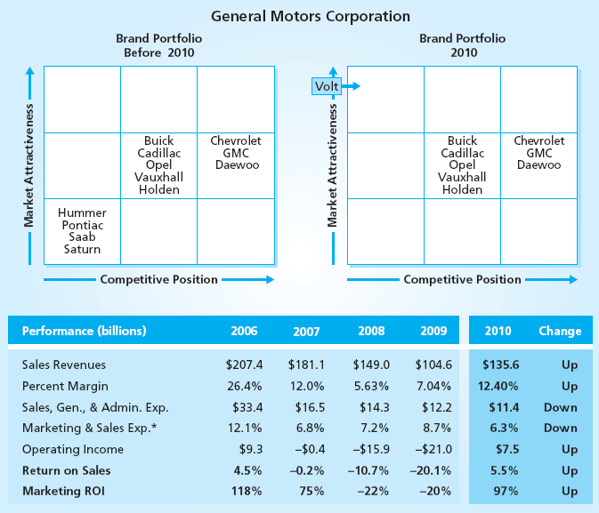
GM Portfolio Strategy
MBM6
Chapter 11
GM Portfolio Strategy
Before 2010
Hold – Brands with average market attractiveness and average to good competitive position were retained.
Divest – The 4 brands with weak market attractiveness and poor competitive positions were divested.
2010.
Hold – The new portfolio retained 8 GM brands with average to good strategic positions.
Invest – Volt was added to the portfolio.
How did the GM Portfolio Strategy impact sales and profits?
Copyright Roger J. Best, 2012

Slide 17
Portfolio Analysis
and Strategic Market Planning
MBM6
Chapter 11
Portfolio Position and Strategic Market Plan
In this section we will focus on different portfolio strategies.
Copyright Roger J. Best, 2012

Slide 18
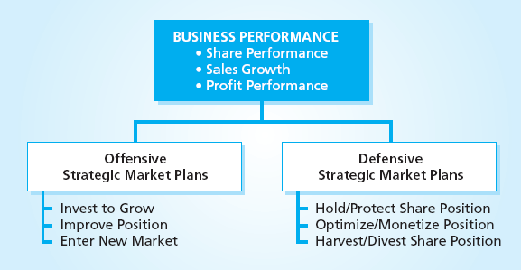
Offensive vs. Defensive Strategies
MBM6
Chapter 11
A business may pursue an Offensive Strategy or Defensive Strategy based on portfolio analysis and business performance objectives.
Copyright Roger J. Best, 2012

Slide 19
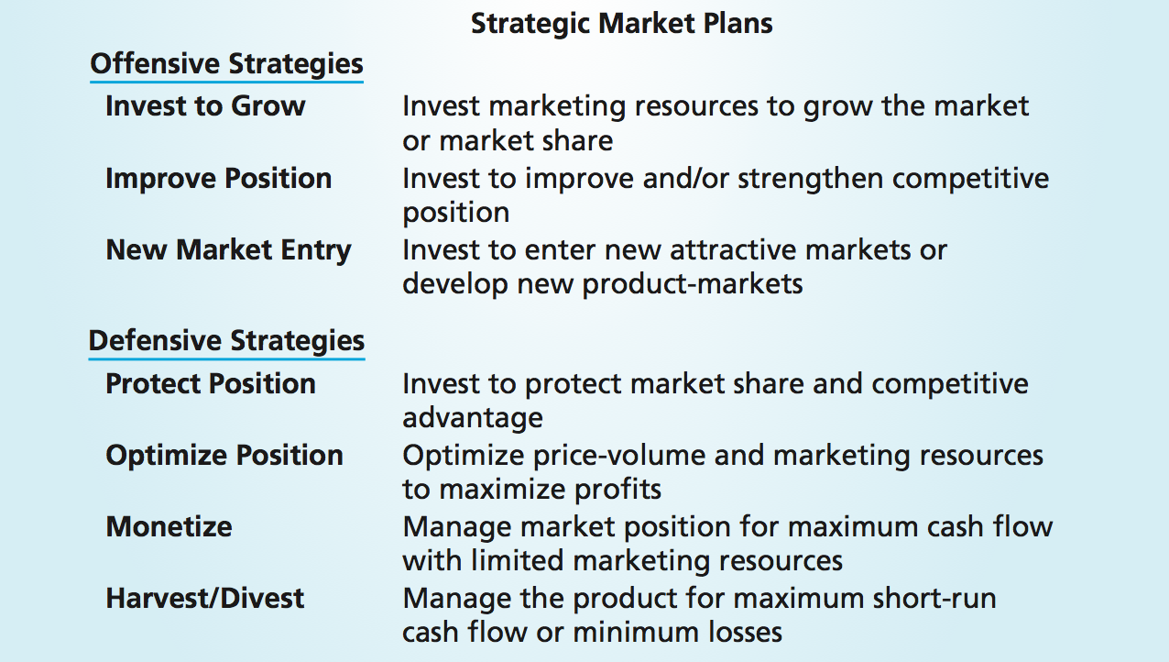
Offensive vs. Defensive Plans
MBM6
Chapter 11
Copyright Roger J. Best, 2012

Slide 20
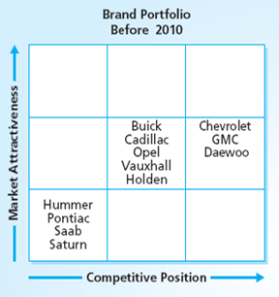
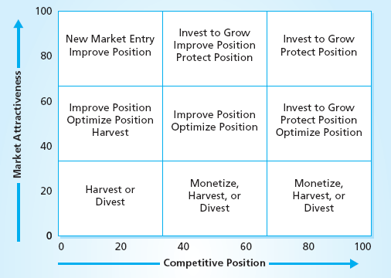
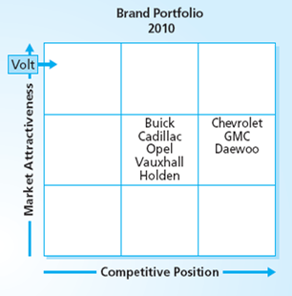
Product Portfolio Position and Portfolio Strategies
MBM6
Chapter 11
How did GM apply the various portfolio strategies to it’s 2010 portfolio?
Copyright Roger J. Best, 2012

Slide 21
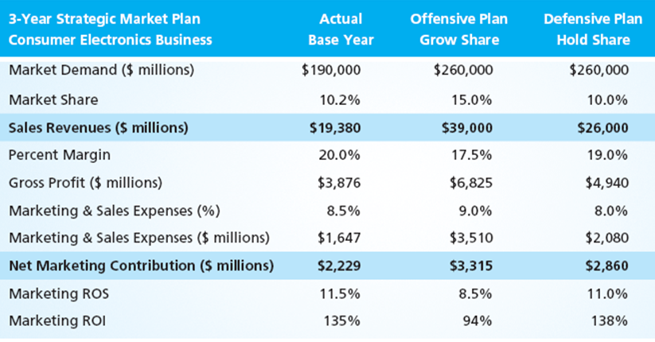
Selecting A Portfolio Strategy
MBM6
Chapter 11
A business may have to look at a defensive strategy when it would prefer an offensive strategy when faced with limited resources.
As the product manager for this consumer electronics product, which portfolio strategy would you prefer to pursue?
Copyright Roger J. Best, 2012

Slide 22
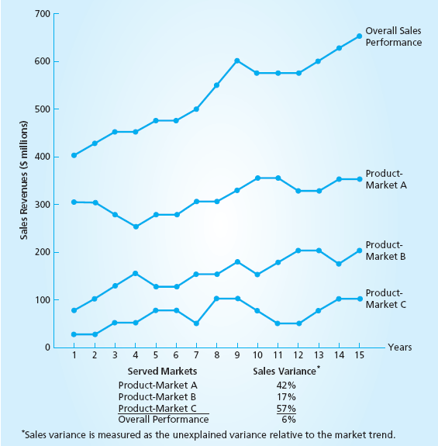
Portfolio Diversification & Performance Variance
MBM6
Chapter 11
Diversified Portfolios
These are portfolios in which individual Product-Markets operate independent from one another.
Performance Variance
The overall performance variance in sales (6%) is much smaller than the individual performance variance of the individual product-markets (17% to 57%)…..Why?
Copyright Roger J. Best, 2012

Slide 23
Portfolio Analysis
and Strategic Market Planning
MBM6
Chapter 11
Portfolio Planning & Portfolio Performance
In this section we will focus on the performance impact of portfolio planning.
Copyright Roger J. Best, 2012

Slide 24
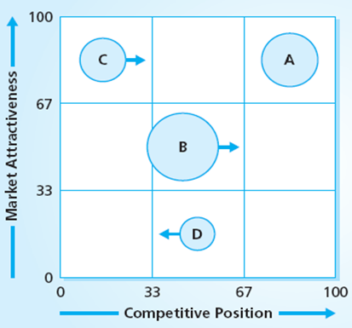
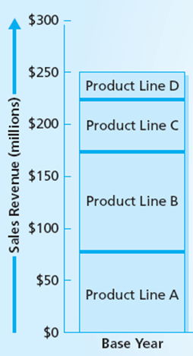
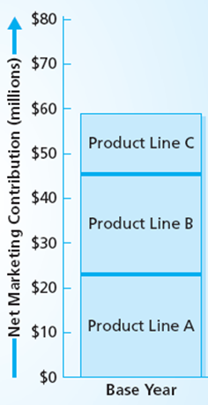
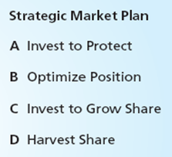
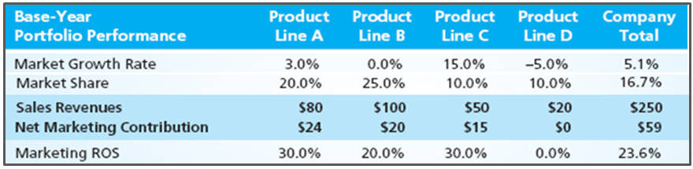
Portfolio Strategy to Grow Sales and Profits
MBM6
Chapter 11
Copyright Roger J. Best, 2012

Slide 25

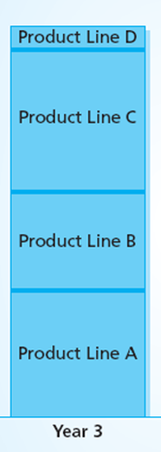
Portfolio Strategy to Grow Sales
MBM6
Chapter 11
C
A
B
D
Current (Base Year)
Plan (Year 3)
Copyright Roger J. Best, 2012

Slide 26

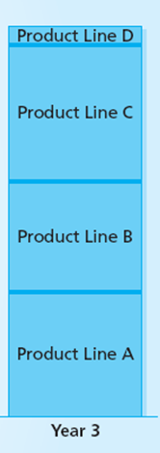
Portfolio Strategy to Grow Marketing Profits
MBM6
Chapter 11
C
Current (Base Year)
Plan (Year 3)
Copyright Roger J. Best, 2012

